Slide 1
Version Control Using GIT
GIT Repositories

Slide 2
Introduction
Understanding repositories
Initialising Repos
Adding files to repos
Committing
Working with file staging
How to stage and unstage a file
Using the Git GUI in conjunction with GIT BASH

Slide 3
GIT Key Concepts - Repos
GIT holds assets in a repository (repo)
A repository is a storage area for your files.
This maps to a directory or folder on your file system
These can include subdirectories and associated files
The repo requires no server but has created a series of hidden files
Located in .git folder
$mkdir firstRepo
$cd firstRepo
$git init
$git status

Slide 4

Creating a Git Repo – Ninja Lab
Create a folder at the ~ called firstRepo
Initialise it as a git repository
Check the status of the repo
Use the touch command to create a file called myfile.bat
Check the status of the repo

Slide 5
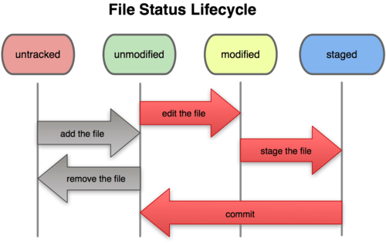
Recording Changes to a Repository
Each file in a git directory can be tracked or untracked
Tracked files are files that were in the last snapshot
They can be unmodified, modified or staged
Untracked files are everything else
Not in your last snapshot or staging area
Notes:
The main tool you use to determine which files are in which state is the git status command. If you run this command directly after a clone, you should see something like this:
$ git status
On branch master nothing to commit, working directory clean

Slide 6
Tracking Files in a Git Repo
To track a file we must add it to the repo
Then we must commit the file – adding to the repository timeline
This will launch the vi editor we must then then:
Switch to input mode (i)
Enter a commit message
Hit ESC to complete the message
Enter ZZ or :wq to exit the vii edit
The master repo is now updated
$ git add FILENAME
$ git commit
$ git status
$ git log
$ git log --stat

Slide 7
GIT Key Concepts - Commits
A commit is a saved change that adds your changes to the history of your repository and assigns a commit name to it.
The change is not sent to a central repository.
Other people can pull the change from you
Or you can push the change to some other repository
There is no automatic updating
Every commit requires a log message
You can add a message by adding -m "your message".
The message can be any valid string
You can also specify multiple paragraphs by passing multiple -m options to git commit.

Slide 8
Adding Multiple Files to a Repo
Adding each file manually is time consuming
Where files already exist you can add by file extension or wildcard
The commit may set the message in a single command
Using the –m flag
$ git add *.c
$ git commit -m 'initial project version‘
Notes:
git add . Will walk through all sub folders and add to staging

Slide 9
Git Tracking and Committing to a Repo – Ninja Lab
Add the myfile.bat to the tracked files of the repo
Commit it
Utilise vi to set its commit message
Check the status of the repo
Create a file called newfile.bat
Add it to the tracked files
Check the status
Commit the file using the –m flag to add a message without using vi
Check the status using the stat flag

Slide 10
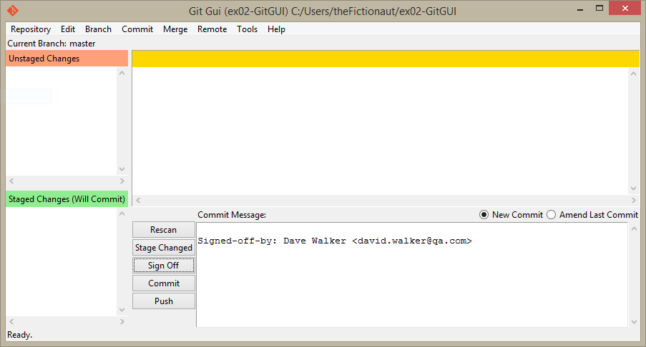
Demonstration – The Git GUI

Slide 11
Conclusion
Repositories are version controlled resources that require no server
Files within a repo can be added to the repo or ignored
Tracked files and their status will be added to the .git resources
Files can be worked with and committed – once committed their log history and the user status is maintained

Slide 12
Workshop – Working With Repos
Part 1 – Using Git Bash to create and stage repos
Part 2 – Using Git GUI to create and stage repos

